Slide 1
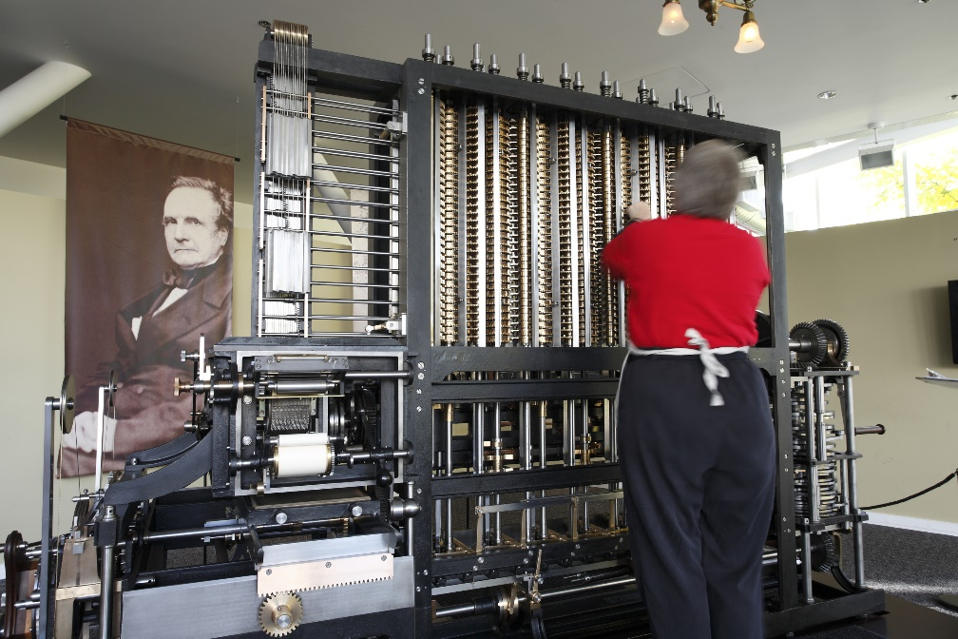
History of Programming
REPL

Slide 2

See Also
https://en.wikipedia.org/wiki/History_of_programming_languages
Notes:
Here is some additional reading about the web … on the web

Slide 3
Assembly Language
Use pseudo language, brief mention of registers. Focus: memory addressing, instructions, goto, conditional, subroutines, indirect jumps, stacks. All these concepts drive the hearts of upper level languages – and the OO process.
They are primitively simple. So simple it is amazing that anything of complexity can be built from them. Our high-level languages hide the tediousness, but you can see the process.
Simple program with one routine. Show stack. Show heap. Show conditionals (and GOTOs)

Slide 4
BASIC
BASIC lets us give names to the memory addresses. Lets us write compound expressions that are systematically broken down into smaller serial units.
No concept of a stack here. No local variables or passing parameters or returning a value.
Interpreted. Not really running native code. Python and JS do this too.

Slide 5
FORTRAN
Compiles. Code becomes a program that runs on the processor in its native language.
Still no stack or locals. Hiding the indexing, addresses, expressions, and control flow.
Breaking program up into reusable modules. STRUCTURED programming.

Slide 6
C
Locals on the stack. Allows recursion.
Not to be confused with structured programming, added structures: the ability to build up data types (similar to building up functions). Ability to talk to the smaller pieces of a larger type. As if these larger types were their own isolated memory spaces.
Pointers to functions (functors)

Slide 7
C++ (Encapsulation)
Lots of functions to work on data structures. Pass the pointer to the data as the first element. (reference up coming materials – this is just an overview).
C++ lets you move the functions into the structures to keep things together. Class (private). Same thing. Convert “class” to “struct” and you get the exact same code.
As if these little objects in memory are islands of functionality and memory. Flip around the call code. Object first … as if calling a function within the tiny memory space. (But we know it isn’t).

Slide 8
C++ (Virtual Pointer Table)
Calling a function indirectly. I don’t know the address, but the object can tell me. Changes the calling code considerably. Allows different objects to implement “writeByte” and “readByte” in different ways. To screen? To disk? To socket? The caller calls the function by name without knowing exactly what it does.
Assembly programmers have been doing this for years. A jump table of functions. BIOS functions that might move around (but not the jump table). C++: some are virtual some aren’t. Only code – not data (java same).
Now in the memory of an object we have a virtual pointer table. C++ and Java, the table is fixed (all objects of a type share it). Java everything is virtual.

Slide 9
Python and JS (Dynamic)
Python and JS allow you to change the pointer to the function at runtime. Do this for awhile, then switch it up.
Everything (even data) is associative. Always look at a map to get data/function. Runtime-OO. Just wire up the objects and let them go. No up-front compile checking.

Slide 10
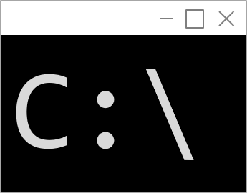
The Command Line
Command Prompt
C:\UAH>py
Python 3.6.4 (v3.6.4:d48eceb, Dec 19 2017, 06:54:40) [MSC v.1900 64 bit (AMD64)] on win32
Type "help", "copyright", "credits" or "license" for more information.
>>> 1+2
3
>>> print(5+5)
10
>>> for x in range(2,5):
... print(x)
...
2
3
4
>>> quit()
C:\UAH>

Slide 11
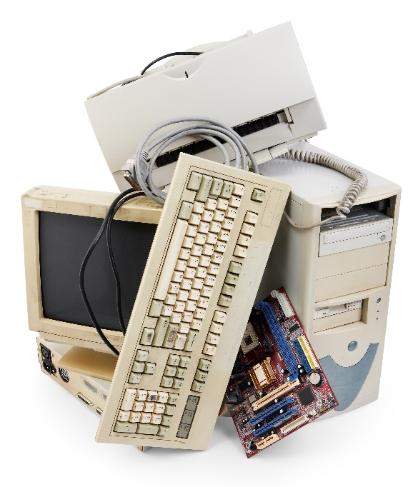
Tinkering
https://skilldrick.github.io/easy6502/ and write some 6502
Look at some of the computer archeology work
Look at the disassembly of a Java program. Of a Python program. Of a C program.

